Slide 1
AP Computer science A:
Unit 1
Teacher: Iddo sadeh
Notes:
Start with introducing yourself.
Get to know students (Name, Grade, Motivation, Previous programming)

Slide 2
What is Computer science?

Slide 3
What is computer science?
It is about computation, not computers!
By learning computer science, we learn to solve problems!
Computer scientists can be great software engineers, the opposite is not always true.
Notes:
Essentially computer science is a branch of math. It is the about computation not computers. Essentially becoming a good computer scientist is actually becoming a good problem solver. (use CRA example)

Slide 4
Why are we learning programing?

Slide 5
Why are we learning programing?
Programing languages are tools that help us solve questions we may not be able to do ourselves
Notes:
Well, Programing languages and computers are tools that allow us to solve problems which may be hard to do in our heads or on paper.

Slide 6
Why learn computer science?
Become a better problem solver!
$$$
Notes:
By studying computer science, you will develop creativity, analytical thinking (turn noisy data in to action!), the ability to work and learn by yourself, and learn useful tools. All these will make you employable in a wide range of jobs.

Slide 7
Future Employment opportunities
Software engineer
Data Scientist
Finance
Research and development

Slide 8
AP Computer science a
Java
1st semester of college

Slide 9

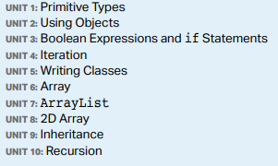
Course structure
First 10 weeks – one unit a week. (hands on programming homework, take home quiz, recommended work)
Then, class time Used for exam preparation. Projects and labs at home.

Slide 10
How to be successful in this course
Make mistakes
Have fun
Work together
Practice, practice, Practice!

Slide 11
Lets start!
1.
Open repl.it or any other IDE or editor.
Make Hello world program
Email me the program at iddosadeh@gmail.com
2.
Download camscanner
Create account
Send me document using camscanner
Notes:
We will be communicating by email. We will be working with an IDE, you can use what ever you are comfortable with. Occasionally I will need you to send me pictures of your work so please download camscanner

Slide 12
Generate output to console
Notes:
System.out.print vs System.out.println
System.out.println(“welcome to CS”)
Ask them to use single quotation instead of double
String literals vs string objects vs charchter constant

Slide 13
Errors!
Syntax
Runtime
Logic

Slide 14
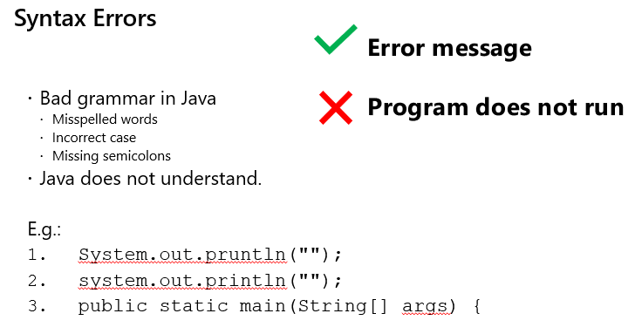

Slide 15
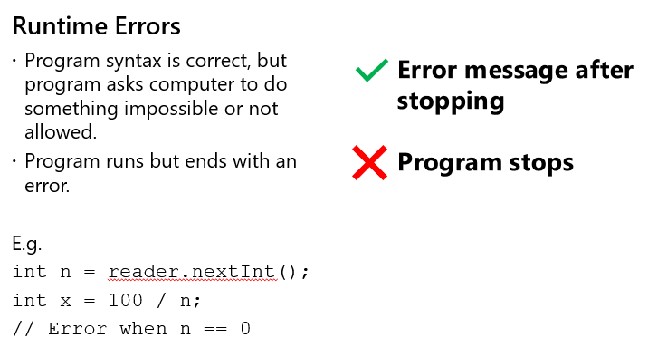

Slide 16
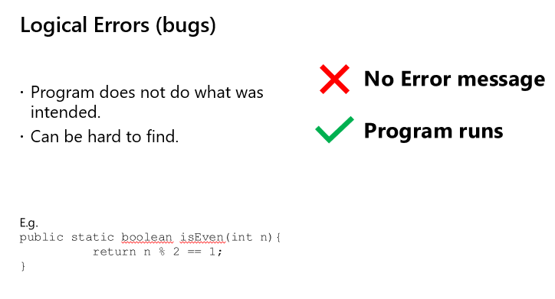

Slide 17
How do we prevent errors
IDE (don’t count on it!)
Comments (good for spotting logic errors)
Psuedocode (can ensure your logic is correct and help avoid runtime errors)
Readable code (can prevent syntax errors)
Practice (even experience programmers still get errors)
Notes:
Make handout for them

Slide 18
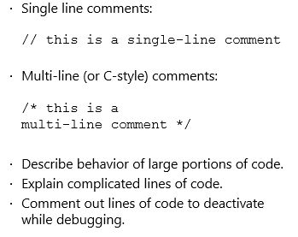
Quick review of comments

Slide 19
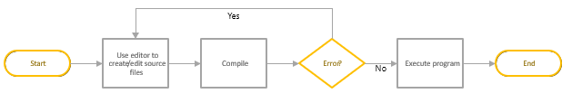
Errors are essential to programming

Slide 20
What is a compiler?
Computer programs are stored as zeroes and ones, called the “machine language”
Writing programs in zeroes and ones is hard!
We use languages (Java, C, Python, etc.) and a compiler that translates what we write to the machine language
Compilers that translate one programming language to another exist
Your IDE or editor has a built in compiler

Slide 21
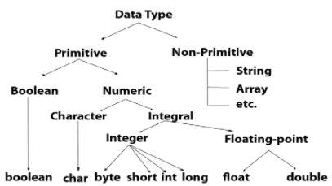
Variables and data types
*Picture taken from https://www.javatpoint.com/java-data-types
Notes:
I will try and incorporate all data types throughout the year.
The main ones for this chapter are int double and Boolean which are primitive
We will touch on string in the next chapter.

Slide 22
Variables
A variable is a piece of memory that can contain a data value. A variable thus has a data type.
A variable allows you to store a value in a named memory location. To create a variable, you must tell Java its data type and its name. Creating a variable is also called declaring a variable.
The type is a keyword like int, double, or boolean, but you get to make up the name for the variable.
To declare (create) a variable, you specify the type, leave at least one space, then the name for the variable and end the line with a semicolon (;).
Notes:
Ask students to create int double and bool variable

Slide 23
More on variables
You can change values of variables throughout the program
You can declare a variable final, its value can then can not be changed

Slide 24
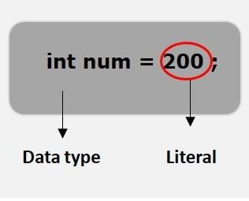
Expressions and assignment statements
*picture taken from https://www.tutorialspoint.com/What-are-literals-in-Java
Notes:
We use the = sign to assign literals to variables. Right is stored in left)
A literal is a source code representation of a fixed value. They are represented directly in the code without any computation.
Literals can be assigned to any primitive type variable.
Literals can be in base 10, base 16, base 8, string.

Slide 25
Arithmetic operators
The arithmetic operators consist of:
+ (Addition)
− (Subtraction)
* (Multiplication)
/ (Division)
% (Remainder)
Notes:
We can use arithmetic operations when assigning values to variables. (Ask students if they are familiar with modulu, if not have them try it out)(have them try out division by zero) Value of ex[ression has a type based on the evaluation of the expression (int double difference)

Slide 26
Compound Assignment Operators
Compound assignment operators (+=, −=, *=, /=, %=) can be used in place of the assignment operator.
The increment operator (++) and decrement operator (−−) are used to add 1 or subtract 1 from the stored value of a variable or an array element. The new value is assigned to the variable or array element.
Notes:
Ask familiarity, go over each one. Make sure they know what everything does)

Slide 27
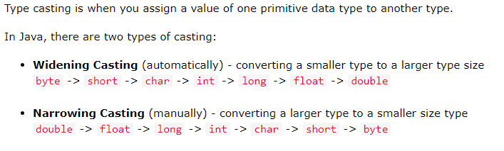
Casting and Ranges of Variables
*screenshot from https://www.w3schools.com/java/java_type_casting.asp
Notes:
2^31

Slide 28
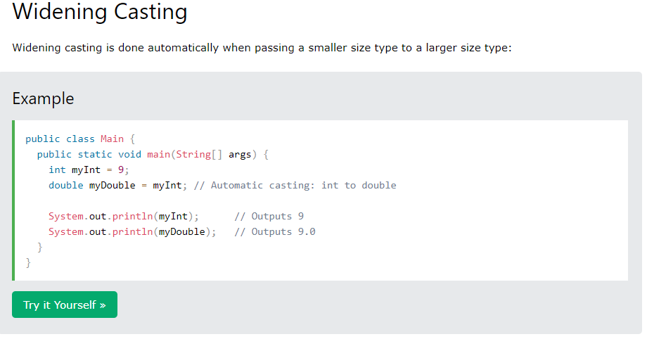

Slide 29
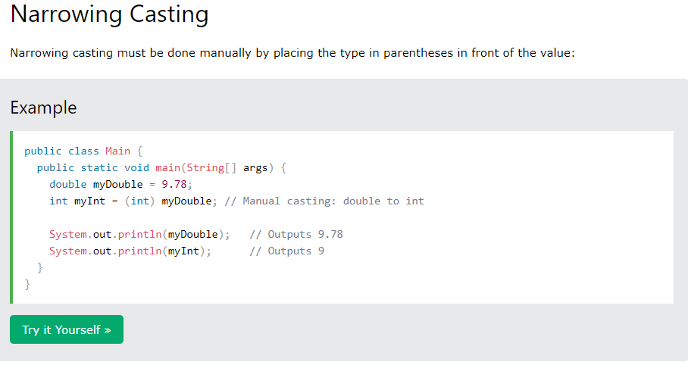
Notes:
Ask about rounding, what is simplest way to fix it?

Slide 30
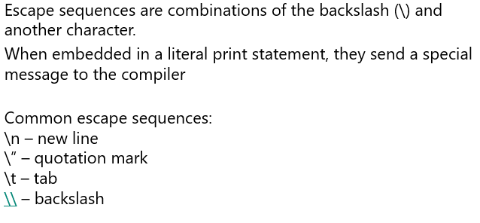
Escape sequences
Notes:
Create a new line between “hello” and “world”
Put “hello world” in quotations

